Slide 1
Institute for Human Resources Development
ul. Nałęczowska 30
20-701 Lublin
Poland

Slide 2
Assistant teacher in pre-school education
Main characteristics

Slide 3
There is no systemic obligation of introducing assistant teacher into pre-school education
As a consequence - it is up to the director of the pre-school institution (budget, needs) if such post is included is staff system
Still, it is very rare to have an assistant teacher in pre-school in Poland (mainly financial reasons, lack of precise definition of role, competencies)

Slide 4
But…
If there is an assistant teacher his/her role and responsibilities are the following:

Slide 5
Assistant teacher works with the director and pedagogical staff on the education of children,
helps to maintain hygienic conditons
helps to maintain comfort and of group work (discipline and safety)

Slide 6
Assistant teacher’ s work is supervised by the is the director of the nursery/kindergarten

Slide 7
Assistant teacher works closely with other regular teachers kindergarten/nursery in support of aesthetics in the classroom and other areas

Slide 8
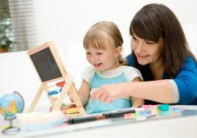
The main roles of the assistant teacher include:

Slide 9
a)assist the teacher in organizing care and educational work,
b) participating in excursions and walks with kids
c) organizing holiday activities for children

Slide 10
d) Help maintaining clenliness in classrooms
e) care for the health and safety of pupils,
f) attention to health and safety and the protection of property of kindergarten

Slide 11
Detailed responsibilities include:
assist the teacher in dressing and undressing children
assist in the care of children during walks and hikes,
Helps organize time of resting for children,

Slide 12
Helps preparing meals,
Assists children during meals

Slide 13
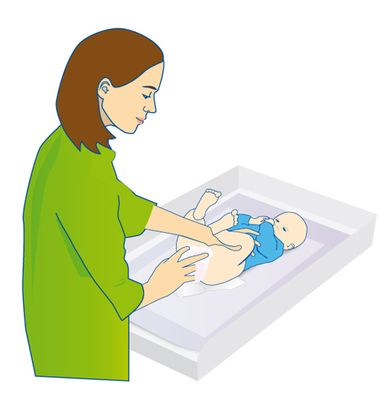
caring for children in the classroom,
assist the teacher in the classroom,
Helps in case of minor health problems
help children with activities of hygiene in the bathroom,

Slide 14
In the Polish system you do not need to have a pedagogical study or pedagogical course to be the assistant teacher

Slide 15
Assistant teacher is not employed under a teacher's card,
but on the basis of the Labour Law

Slide 16
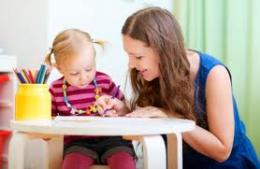
Assistant teacher is often employed in a special kindergarden for mentally and physically disabled children

Slide 17
responsibilities of assistant teacher may be different in different nursery/kindergaredn,
dependent on the needs of children,
taking into account their age, stage of development and eventual disability,
as well as the required support for teachers, due to their pedagogical workload.

Slide 18
Thank you for your attention

